Slide 1
Graph Algorithms: BFS, DFS & Topological Sort
Session 19
Henry Lucky, S.Kom., M.Kom.

Slide 2
Learning Outcomes
Session 19
This session addresses LO 1, LO 2, and LO 3.
LO 1: Evaluate the time and space complexity of algorithms using asymptotic notation and formal analysis methods, and prove algorithm correctness using loop invariants, induction, or exchange arguments.
LO 2: Analyze unfamiliar computational problems by identifying their structural properties, classifying them into known algorithmic categories including graph, string, and combinatorial problems and recommending a solution strategy with justification.
LO 3: Design solutions to unfamiliar computational problems by selecting and applying appropriate strategies including Divide and Conquer, Greedy, Dynamic Programming, and Backtracking.

Slide 3
Learning Outcomes
Session 19
By the end of this session, students will be able to:
LO 1 - Analyze BFS and DFS at O(V+E); apply the Parenthesis Theorem to DFS discovery/finish intervals; evaluate edge classification (tree, back, forward, cross) and its implications for cycle detection.
LO 2 - Classify graph problems (unweighted shortest path, topological ordering, SCC, cycle detection) and select among BFS, DFS, Kahn's, and Kosaraju's algorithms based on problem type and graph properties.
LO 3 - Design BFS-based unweighted SSSP, DFS-based topological sort, DAG-SSSP with topological-order relaxation, and Kosaraju's SCC (two DFS passes on G and Gᵀ).

Slide 4
outline
Session 19
BFS — Shortest Path in Unweighted Graphs, Layered Traversal
DFS — Discovery/Finish Times, Edge Classification
Topological Sort — DFS-Based
DAG Applications — Scheduling, Dependency Resolution
Connected Components

Slide 5
Introduction to Natural Language Processing
Why Natural Language Processing?
What do we use language for?
  We communicate using language
  We think (partly) with language
  We build scientific theories with language
  We make friends/build relationships
Why NLP?
  Access knowledge (search engine, recommender system…)
  Communicate (Translation)
  Linguistics and Cognitive sciences (Language analysis)

Slide 6
Introduction to Natural Language Processing
Why Natural Language Processing?
Amount of online textual data…
  30+ billions web-pages online (1+ billion websites).
  60 million pages of of Wikipedia articles containing over 4.5 billion words
…Growing at a fast pace
  6000 tweets / second
  3 million mail / second (60% spam)
Notes:
https://siteefy.com/how-many-websites-are-there/
https://whatsthebigdata.com/twitter-statistics/#

Slide 7
Introduction to Natural Language Processing
Why Natural Language Processing?
Potential users of NLP
  8.08 billion people use some sort of language (January 2024)
  5.35 billion internet users (January 2024)
  5.04 billion active social media users (January 2024)
Notes:
https://datareportal.com/reports/digital-2024-global-overview-report

Slide 8
Introduction to Natural Language Processing
Why Natural Language Processing?
What Products?
  Search Engine: 2.4 billion Google users, 206 million Baidu users (January 2024)
  Social Media: +4 billion of Social Media users (Facebook, Youtube, Instagram, Twitter, Whatsapp) (January 2024)
  Chatbot: 180 million users of ChatGPT (February 2024)
  Machine Translation: 712M total visits for Google Translate (March 2024)
Notes:
https://datareportal.com/reports/digital-2024-global-overview-report
https://explodingtopics.com/blog/chatgpt-users#top
https://www.similarweb.com/website/translate.google.com

Slide 9
Introduction to Natural Language Processing
What is Natural Language Processing?
NLP is about teaching computers to understand and interpret human language (natural language).
It allows us to interact and communicate with computers using natural language, like we would with another person.
NLP helps computers understand the meaning and context behind words and sentences.
  This includes recognizing different languages, understanding slang or colloquial expressions, and even detecting emotions in text.

Slide 10
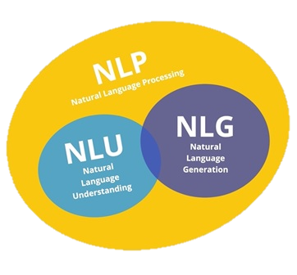
Introduction to Natural Language Processing
What is Natural Language Processing?
Generally, there are 2 components of NLP:
  NLU: involves breaking down human language into a machine-readable format, i.e. from text to meaning.
  NLG: is the process of constructing output in the form of natural language from non-linguistic input, namely producing text from structured data.

Slide 11
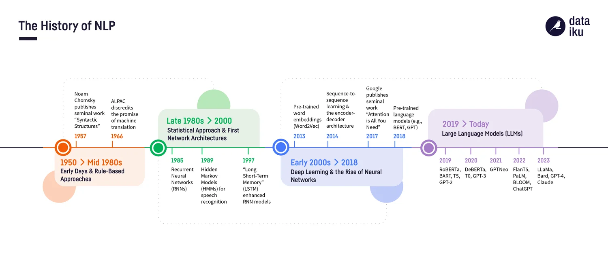
Introduction to natural language processing
Timeline of NLP developments

Slide 12
Introduction to natural language processing
State of the art: LLM
Large Language Model is Advanced NLP models with billions of parameters, trained on vast datasets to understand and generate human-like text (Ex: GPT-4, BERT, T5, etc).
Key features:
  Contextual Understanding: Ability to understand and generate contextually relevant text.
  Transfer Learning: Fine-tuning on specific tasks after pre-training on large datasets.
  Scalability: Performance improves with more data and larger model sizes.

Slide 13
Introduction to natural language processing
State of the art: LLM
Recent Advancements:
  DeepSeek R1: Introduced new way to train AI chatbot for “reasoning” and achieving comparable or better performance to other Chatbot at the time with much lower GPU training budget.
  OpenAI’s gpt-oss models: among the earlier models released in 2025 that were specifically developed with tool use in mind.
  Llama 4: scored extremely well across many established benchmarks.
    However, once users and developers got their hands on it, they realized that these scores didn’t reflect the real-world capabilities and usefulness due to possible benchmaxxing (2025 tech trend)

Slide 14
Introduction to natural language processing
Applications
Some applications of NLP:
  Text Classification (e.g., spam detection)
  Machine Translation (e.g., Google Translate)
  Sentiment Analysis (e.g., product reviews)
  Speech Recognition (e.g., Siri, Alexa)
  Chatbots and Conversational Agents

Slide 15
Text analysis
Sentiment analysis
Sentiment analysis is a branch of text analysis that focuses on understanding the emotions and opinions expressed in text data.
It involves automatically classifying text as positive, negative, or neutral based on the sentiment conveyed by the words and phrases used.
Sentiment analysis has various applications across industries.
It's used in social media monitoring to gauge public opinion, in customer service to analyze feedback, in market research to understand consumer sentiment, and in product reviews to assess customer satisfaction.

Slide 16
Text analysis
Sentiment analysis
A simple implementation of sentiment analysis can be done using ChatGPT with the right prompt.
User :
From now on, you are going to classify the sentiment of the text given with one word into good, neutral or bad
Understood! I'll classify the sentiment of the text into "good", "neutral", or "bad" based on its overall sentiment. Let me know if you have any text you'd like me to analyze.
Overall, dining at this restaurant was a delight from start to finish. The delicious food, impeccable service, and charming ambiance made for a memorable experience.
The sentiment of the text is "good".
ChatGPT :
User :
ChatGPT :

Slide 17
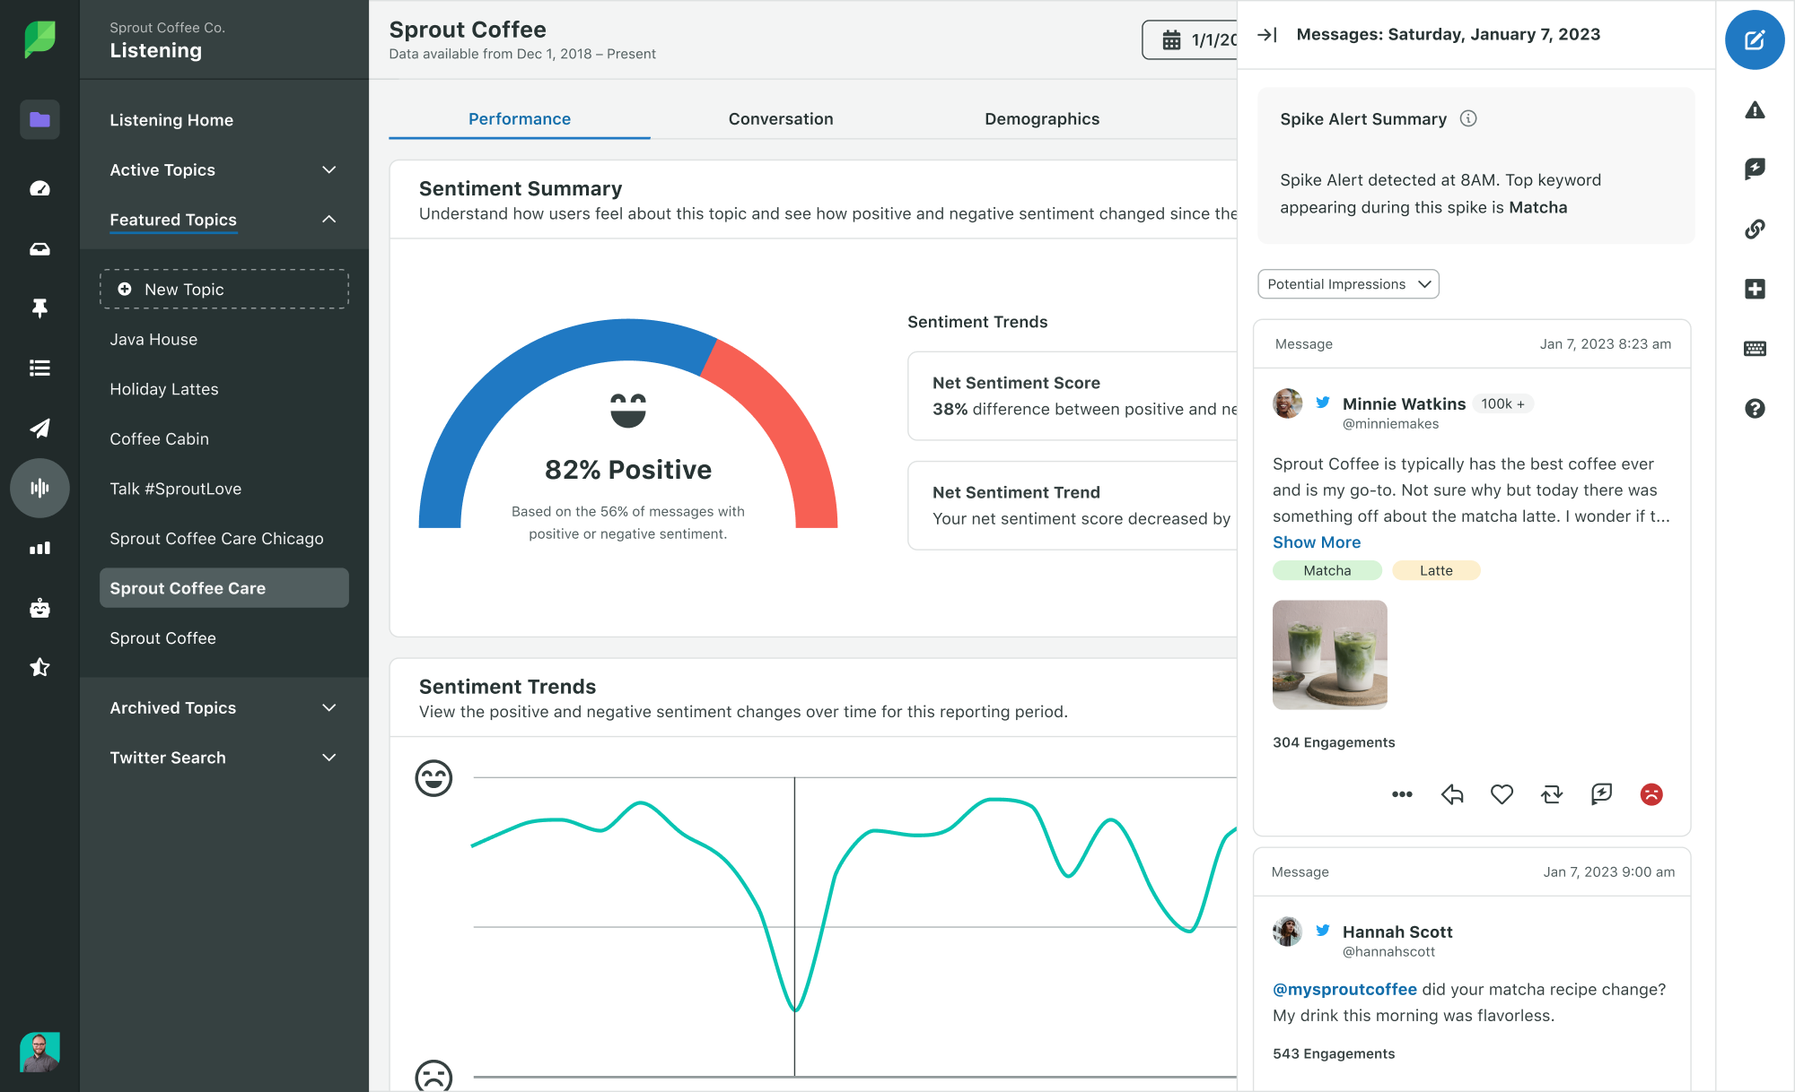
Text analysis
Sentiment analysis
A more applicative use of sentiment analysis is Social Media Listening tools.
Some of the tools are Hootsuite, Sprout, Brand24, Brandwatch, Awario

Slide 18
Text Generation
Chatbots
Text generation is a subset of NLP that focuses on producing human-like text.
Chatbots are computer programs designed to simulate human conversation.
They interact with users through text or speech, responding to queries and providing assistance.
Chatbots are commonly used in personal assistants like Siri, Google Assistant, and Alexa, as well as in customer service applications on websites and messaging platforms. (Also, ChatGPT)

Slide 19
Text Generation
Image/video captioning
Text generation is used to automatically create captions for images, videos, or other media content.
This helps in making content more accessible and engaging, especially for visually impaired individuals or those who prefer text-based content.
Advanced text generation models can understand the context of the image or video and generate captions that accurately describe the scene (not a speech-to-text technology).
  This includes identifying objects, actions, emotions, and other elements within the content.

Slide 20
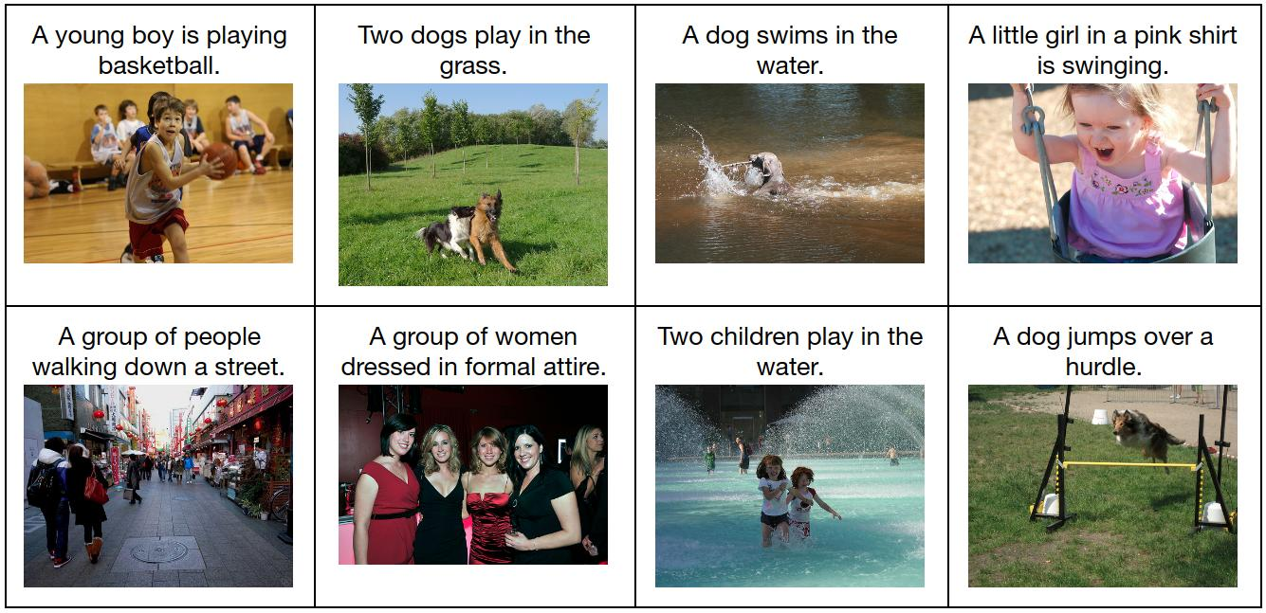
Text Generation
Image captioning

Slide 21
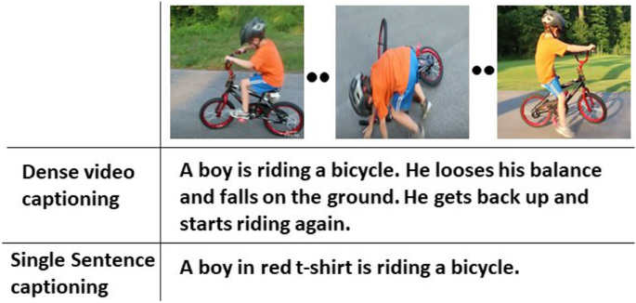
Text Generation
video captioning

Slide 22
Text Generation
Image/video captioning
Automated captioning has various applications across industries, including social media, e-commerce, education, and entertainment.
It can enhance user engagement, improve accessibility, and streamline content creation processes.
One example tool to make caption for social media is: https://image-to-caption.com/

Slide 23
Text Generation
Machine translation
Machine translation is the process of automatically translating text from one language to another using computer algorithms.
It aims to bridge language barriers and facilitate communication between people who speak different languages.
Over time, machine translation has become more accurate thanks to advancements in artificial intelligence and large datasets.
Machine translation works best for widely spoken languages like English, Spanish, French, and Chinese, where there is ample training data available.

Slide 24
Text Generation
Summarization
Text summarization takes a large amount of information and condenses it into a shorter, more manageable form.
Instead of reading through long articles or documents, text summarization helps people quickly grasp the main points and key ideas.
Text summarization algorithms are designed to understand the main themes and important information in a piece of text.
  They can identify key sentences and phrases that capture the essence of the content.

Slide 25
Text Generation
Summarization
Text summarization is used in various applications, such as:
  News aggregation websites, where headlines and summaries provide a quick overview of the day's events.
  Research, helping scientists quickly review relevant literature.
There are different approaches to text summarization, including extractive and abstractive methods.
  Extractive summarization selects and combines existing sentences from the original text,
  Abstractive summarization generates new sentences to convey the main ideas.

Slide 26
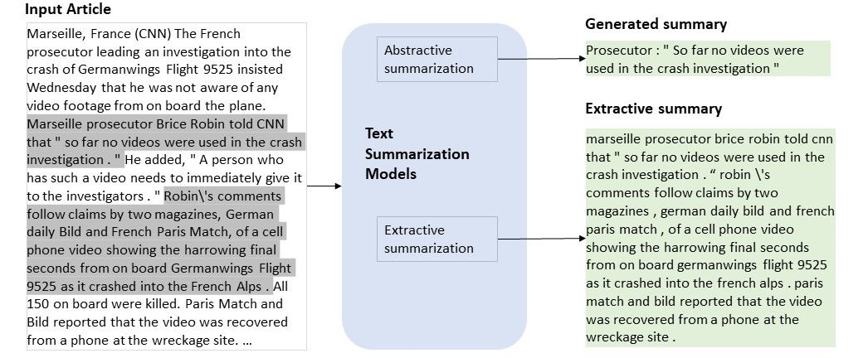
Text Generation
Summarization

Slide 27
Prompt Engineering
Prompting Basic
Prompts are your input into the AI system to obtain specific results.
In other words, prompts are conversation starters: what and how you tell something to the AI for it to respond in a way that generates useful responses for you.
Understanding what makes an effective prompt and learning to craft prompts on the fly can boost your productivity and creativity when using AI.

Slide 28
Prompt Engineering
Components of effective prompt
There are 4 components to consider in writing effective prompts:
  Persona: specific character or identity for the language model to adopt. This helps the model generate responses that are consistent with the assigned role and its associated knowledge and behaviour.
  Task: What things do you want the AI to do?
  Context: specific details or background information relevant to the current conversation or task. It helps the model to understand the nuances of what’s being asked and tailor the response accordingly.
  Output Format: How do you want to format the output of the AI?

Slide 29
Prompt Engineering
Components of effective prompt
Example of prompt:
You are a program manager in [industry]. Draft an executive summary email to [persona] based on [details about relevant program docs]. Limit to bullet points.
You don’t need to use all four components in every prompt, but using a few will help!
Always remember to include a verb or command as part of your task; this is the most important part of a prompt.
Persona Task Context Output Format
Notes:
More examples in reference

Slide 30
Prompt Engineering
Five Tips on Prompting
Use natural language. Write as if you’re speaking to another person. Express complete thoughts in full sentences.
Be specific and iterate. Tell AI what you need it to do (summarize, write, change the tone, create). Use both instructions (language that guides the model on what it should do or produce) and constraints (a set of limitations or boundaries on the response; it limits what the model should avoid) to help guide the output.
Be concise and avoid complexity. State your request in brief — but specific — language. Avoid jargon.
Make it a conversation. Fine-tune your prompts if the results don’t meet your expectations or if you believe there’s room for improvement. Use follow up prompts and an iterative process of review and refinement to yield better results.
Use your documents. Personalize AI’s output with information from your own files.

Slide 31
Prompt Engineering
Generative AI Awareness
Generative AI and all of its possibilities are exciting, but it’s still new.
Even though the models are getting better every day, prompts can sometimes have unpredictable responses.
Before putting an output from AI into action, review it to ensure clarity, relevance, and accuracy.
And of course, keep the most important thing in mind: Generative AI is meant to help humans but the final output is yours.

Slide 32
Case study
Language learning robots
With the advanced AI, computing, and robotic technology, nowadays companion robots are capable to provide dynamic services, such as foreign Language Learning Robots (LLR) to teach students how to speak foreign languages, i.e. English LLR teach Asian students to learn English, or Spanish LLR teach English-language-oriented students to learn Spanish in their daily activities.
Discuss in a group and explain how machine learning techniques can be applied to English Learning for Indonesian students?
How is the implementation of English Learning Robot?

Slide 33
Case study
AI Chatbots
What are the limitations of an AI Chatbot?
  Is it flawless? To what extent should you believe it?
  How do you actively learning when using it?
  Are there any (potential) harm in using it?

Slide 34
References
Session 4
Raymond S. T. Lee. 2020. Artificial Intelligence in Daily Life. Springer. China. ISBN 9789811576959
https://image-to-caption.com/
ChatGPT https://openai.com/blog/chatgpt
Quillbot https://quillbot.com/summarize
Google translate https://translate.google.com
Prompting Guide 101: https://services.google.com/fh/files/misc/workspace_with_gemini_prompting_guide.pdf

